Slide 1
Computer Network
Benefits of a Computer Network
A computer network is a group of two or more computers interconnected via cables or through wireless mode, for sharing hardware and software resources.
Some examples of a computers networks are:
Computers in a lab are interconnected using a network to share a single printer or software.
Files shared between computers within a building through a computer network.
File Sharing
Hardware Sharing
Software Sharing
Cost Reduction
Efficient Systems Management
Enables Real-time Communication

Slide 2
Drawbacks of a Computer Network
Classification of network based on size
LAN (Local area Network)
WLAN (Wireless Local Area Network)
MAN (Metropolitan Area Network)
WAN (Wide Area Network)
PAN (Personal Area Network)
CAN (Campus Area Network)
SAN (Storage Area Network)
VPN (Virtual Private Network)
High Installation Costs
Risk of Hacking
Hardware Damages

Slide 3
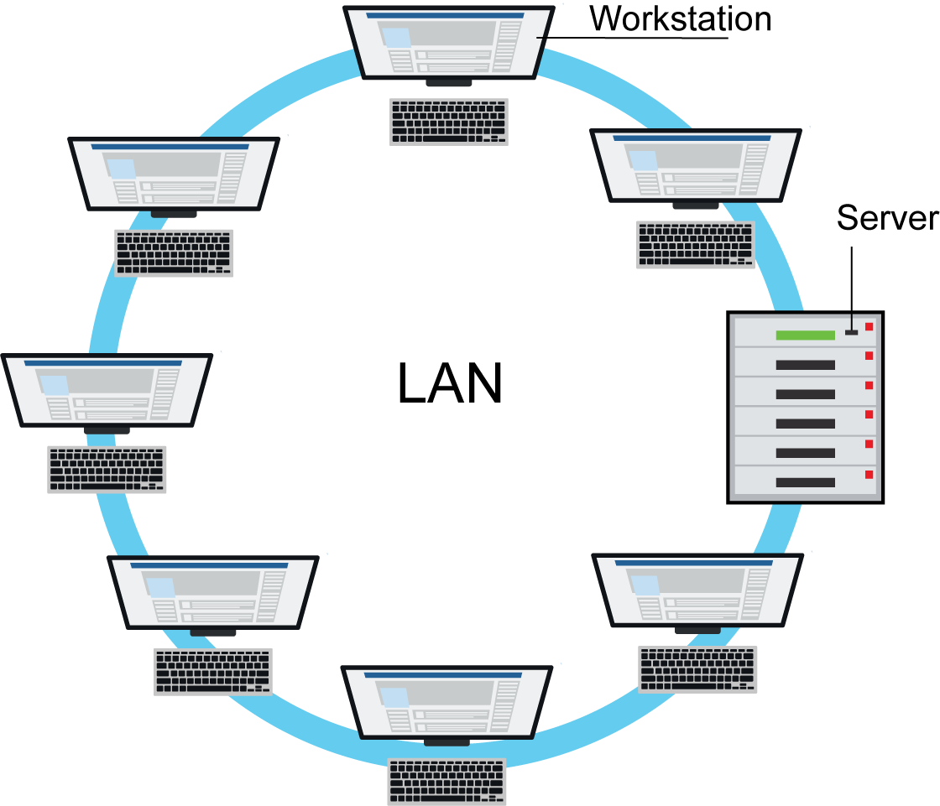
LAN (Local area Network)
Figure: Show the example of Local Area Network
It is a network that is confined to a small geographical area such as a school, office, or multiple offices within a campus. However, a single LAN can be connected to other LANs over long distance via telephone lines and radio waves. The LAN is a private network which can restrict communication to the nodes within the network and prevent it from reaching the Internet.

Slide 4
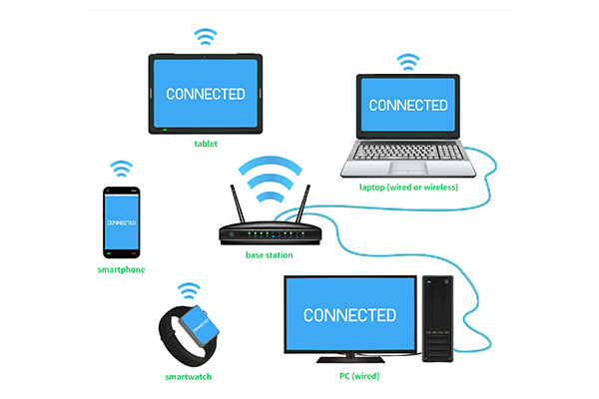
WLAN (Wireless Local Area Network)
Figure: Show the example of Wireless Local Area Network
A wireless LAN (WLAN) is a wireless computer network that links two or more devices using wireless communication to form a local area network (LAN) within a limited area such as a home, school, computer laboratory, campus, or office building.

Slide 5
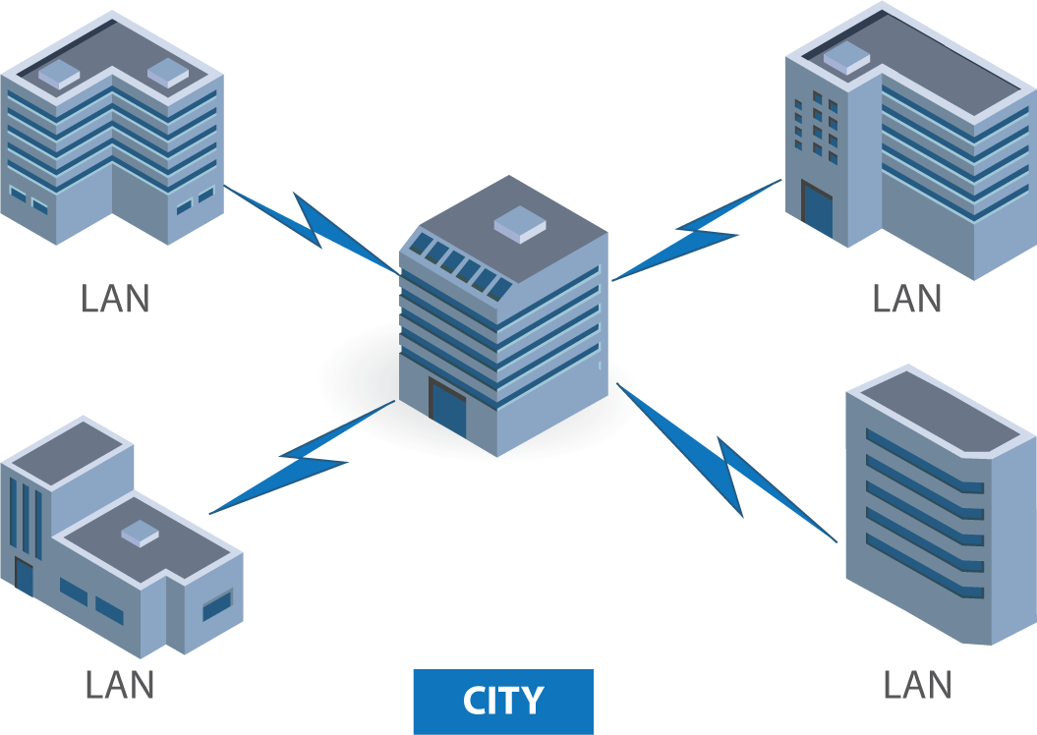
MAN (Metropolitan Area Network)
Figure: Show the example of Metropolitan Area Network
MAN is a large, high-speed computer network that usually spans a large campus or an entire city. A MAN usually interconnects multiple LANs using high-capacity fiber-optical links. MAN covers the geographical area larger than the LAN but smaller than the area covered by a WAN. Companies that use MAN usually have several branches within a city such as banks, local ISPs, cable television companies and local telephone companies. Metro Ethernet is one of the latest forms of MAN.

Slide 6
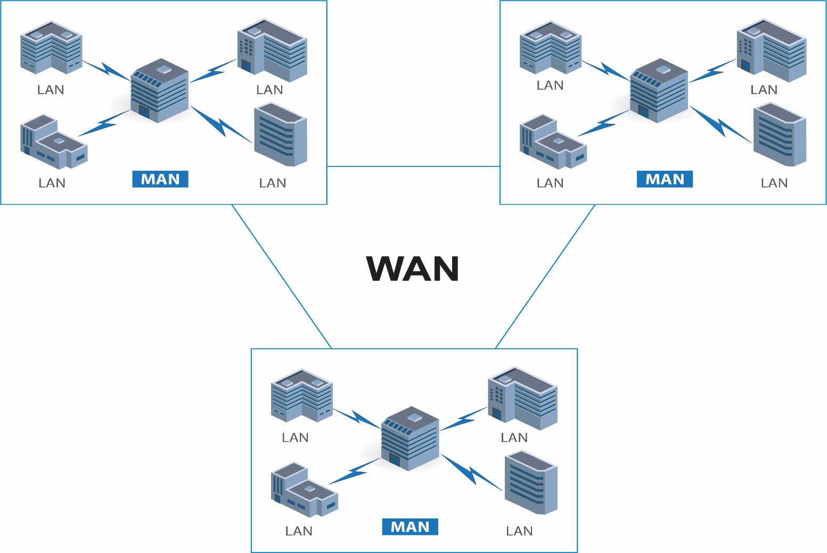
WAN (Wide Area Network)
Figure: Show the example of Wide Area Network
It is a network that spans over a large geographical area, such as a country or the entire world. A WAN can contain multiple smaller networks, such as LANs and MANs. WANs are used by large organizations to interconnect LANs at offices in different countries. The Internet is the biggest public WAN and a network of ATMs is a private WAN.

Slide 7
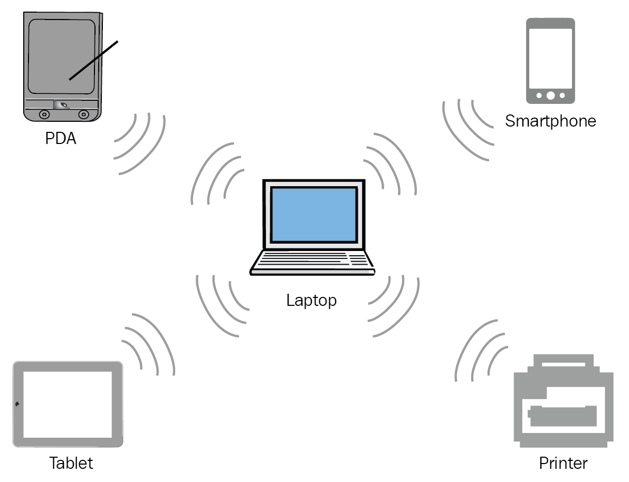
PAN (Personal Area Network)
Figure: Show the example of Personal Area Network
A PAN is defined as a computer network that is used to connect and transmit data among devices located in a personal area, usually over Bluetooth or Wi-Fi to interconnect devices. Occasionally, this computer network is called a home area network (HAN).

Slide 8
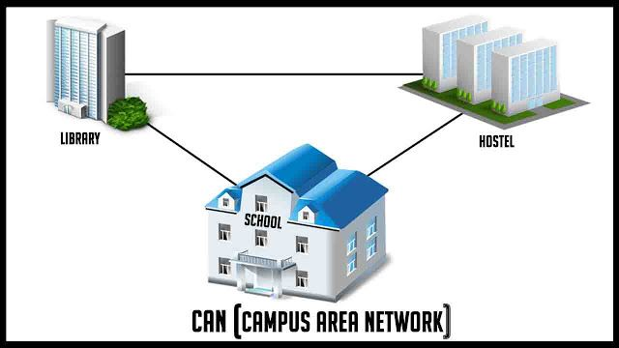
CAN (Campus Area Network)
Figure: Show the example of Wide Area Network
The Campus Area Network (CAN) is a network of several LANs interconnected in a limited geographical area. This is a network which is larger than a LAN, but smaller than an MAN. CAN is smaller than a Wide Area Network (WAN). CAN is also known as the Company Area Network (CAN).

Slide 9
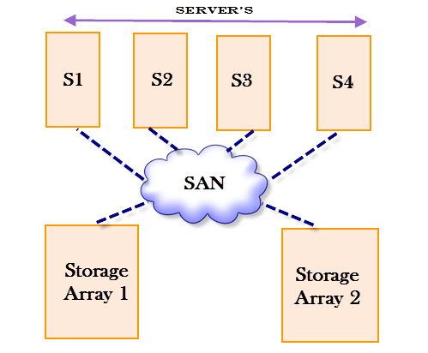
Figure: Show the example of Wide Area Network
SAN (Storage Area Network)
This network connects servers directly to devices which store amounts of data as a dedicated high-speed network that connects shared pools of storage devices to several servers.

Slide 10
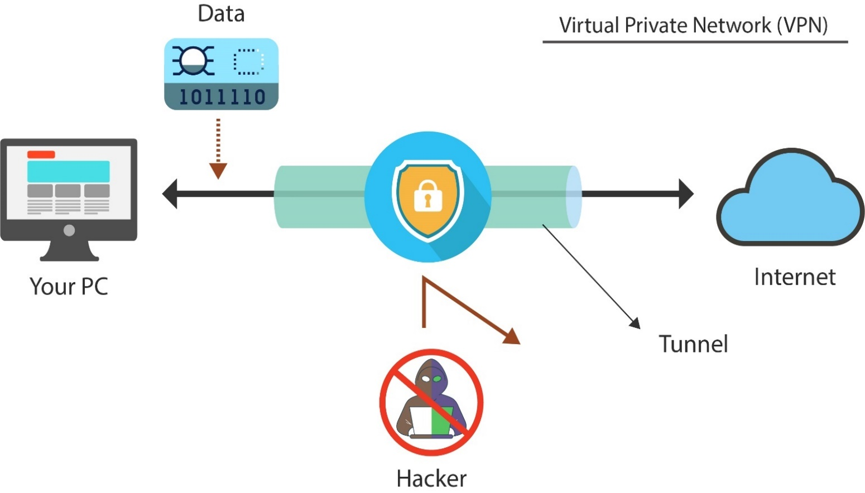
VPN (Virtual Private Network)
Figure: Show the example of Virtual Private Network
It is a type of network that allows computers or an entire network to connect to each other over the Internet securely. VPN is based on the client-server architecture so it consists of a VPN client and VPN server and the software that enables secure connections. VPN uses different security tools such as tunneling protocol. The tunneling protocol creates a tunnel between two devices and encrypts all the information in the tunnel.

Slide 11
Network Terminologies
Network Device:
Here are some IT terms and terminologies that you are likely to come across while working with networks. Let’s look at some of the commonly used terms related to networking:
A networks devices is a hardware components that is required for connecting computers in a network.
Network Nodes:
Network Interface Card:
Computers systems connected to a network are termed as network nodes.
Network Interface Card (NIC) is an electronic circuit card that is required to connect any computer to a network.

Slide 12
MAC Address:
IP Address:
It is a computer’s unique 48-bit hardware address assigned to the network interface for data communication at the data link layer. The NIC manufacturer assigns MAC addresses into the Local Ares Network (LAN) card for wired networks and Wi-Fi card for wireless networks.
IP address is 32-bit address assigned to each node or computer in a Transfer Control Protocol/Internet Protocol (TCP/IP) network. IP address helps in identifying a particular node in a network of nodes for data communication.
Uniform Resource Locator (URL):
Network Port:
URL is a Web address assigned to a resource. It specifies its location on the network of networks.
A port is a unique number of a network process or application to which, a Web or network message is required to be delivered.

Slide 13
World Wide Web:
Network Gateway
World Wide Web or WWW is a database of information on the internet where Web pages are interconnected with hypertext links.
A gateway is a network node that connects two networks with different protocols. A network gateway can either be hardware, a software or combination of both.
TCP/IP
TCP/IP is a protocol used for data communication over the Internet. TCP is responsible for reliable data transmission over the Internet. The Internet protocol is responsible for forwarding packet from one computer to another over the Internet.
Protocol
Protocol is defined as a set of communication rules required for data transmission over the Internet.

Slide 14
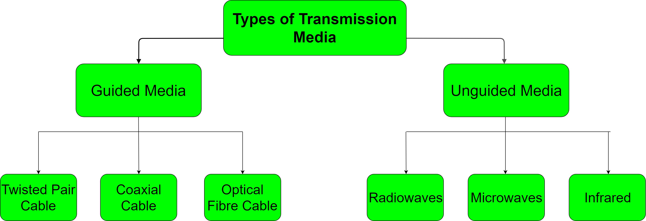
Transmission Media
In data communication terminology, a transmission medium is a physical path between the transmitter and the receiver it is the channel through which data is sent from one place to another.

Slide 15
Guided Media:
There are 3 major types of Guided Media:
Twisted Pair Cable –
It is also referred to as Wired or Bounded transmission media.
Twisted Pair is of two types:
Features:
Unshielded Twisted Pair (UTP):
High Speed
Secure
Used for comparatively shorter distances
This type of cable has the ability to block interference and does not depend on a physical shield for this purpose. It is used for telephonic applications.

Slide 16
Advantages of UTP Cable
Shielded Twisted Pair (STP):
Least expensive
Easy to install
High speed capacity
This type of cable consists of a special jacket to block external interference. It is used in fast-data-rate Ethernet and in voice and data channels of telephone lines
Disadvantages UTP Cable
Susceptible to external interference
Lower capacity and performance in comparison to STP
Short distance transmission due to attenuation
Advantages of STP Cable
Better performance at a higher data rate in comparison to UTP
Eliminates crosstalk
Comparatively faster

Slide 17
Disadvantages of STP Cable
Advantages of Coaxial Cable
Comparatively difficult to install and manufacture
More expensive
Bulky
High Bandwidth
Better noise Immunity
Easy to install and expand
Inexpensive
Coaxial Cable
Disadvantages of Coaxial Cable
Coaxial cable transmits information in two modes: Baseband mode (dedicated cable bandwidth) and Broadband mode (cable bandwidth is split into separate ranges). Cable TVs and analog television networks widely use Coaxial cables.
Single cable failure can disrupt the entire network

Slide 18
Optical Fiber Cable
Disadvantages of Optic Fiber Cable
It uses the concept of reflection of light through a core made up of glass or plastic. The core is surrounded by a less dense glass or plastic covering called the cladding. It is used for transmission of large volumes of data.
Difficult to install and maintain
High cost
Fragile
Advantages of Optic Fiber Cable
Increased capacity and bandwidth
Light weight
Less signal attenuation

Slide 19
Unguided Media
There are 3 major types of Unguided Media
It is also referred to as Wireless or Unbounded transmission media. No physical medium is required for the transmission of electromagnetic signals.
Radio waves
These are easy to generate and can penetrate through buildings. The sending and receiving antennas need not be aligned.
Frequency Range: 3 KHz – 1GHz.
Features:
Microwaves
The distance covered by the signal is directly proportional to the height of the antenna. Frequency Range: 1GHz – 300GHz. These are majorly used for mobile phone communication and television distribution.
Signal is broadcasted through air
Less Secure
Used for larger distances

Slide 20
Infrared
Infrared waves are used for very short distance communication. This prevents interference between systems. Frequency Range: 300GHz – 400THz. It is used in TV remotes, wireless mouse, keyboard, printer, etc.

Slide 21
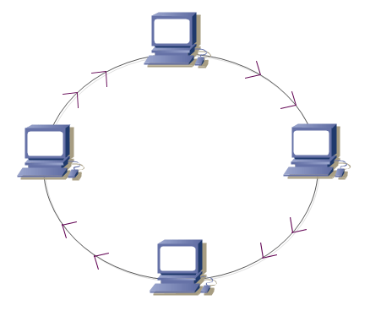
Network Topologies
Ring Topology
A topology is defined as the arrangement of network nodes, cables etc. in a computer network. This arrangement gives a topological structure to a network.
In this topology, each network is connected to exactly two network nodes forming a circular shape or ring
Types of Network Topology
Ring Topology.
Bus Topology.
Star Topology.
Hybrid Topology / Tree Topology
Mesh Topology.

Slide 22
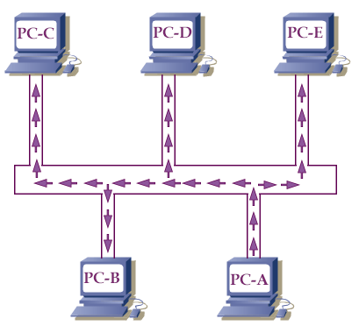
Advantages of Ring topology:
Bus Topology
The possibility of collision is minimum in this type of topology.
Cheap to install and expand.
Bus topology is a network type in which every computer and network device is connected to single cable.
Drawbacks of Ring topology:
Troubleshooting is difficult in this topology.
Addition of stations in between or removal of stations can disturb the whole topology.

Slide 23
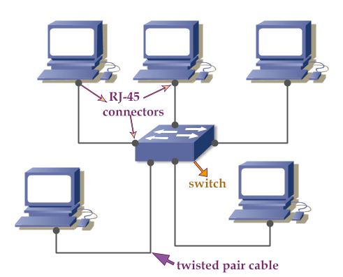
Advantages of Bus topology:
Star Topology
Easy to install
Low installation cost
Useful for small networks like LAN
In star topology, there is a central node that transmits messages. Each node in a star topology is connected to the central node. Network nodes are interconnected with each other through the central node.
Drawbacks of Bus topology:
If the common cable fails, then the whole system will crash down.
If the network traffic is heavy, it increases collisions in the network.
Higher maintenance cost

Slide 24
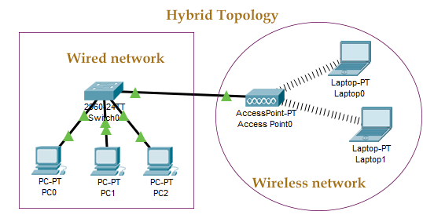
Advantages of this topology:
Hybrid Topology / Tree Topology
If there is a node failure then, only that particular node is affected. All other nodes connected to the central node remain unaffected.
Addition or deletion of network nodes in a star topology is easier and can be done without affecting the entire network.
This topology is a mix of two or more topologies. For example, there are two networks; one is built from the star topology and another is built from the bus topology.
Drawbacks of Star topology:
If the concentrator (hub) on which the whole topology relies fails, the whole system will crash down.
Cost of installation is high.

Slide 25
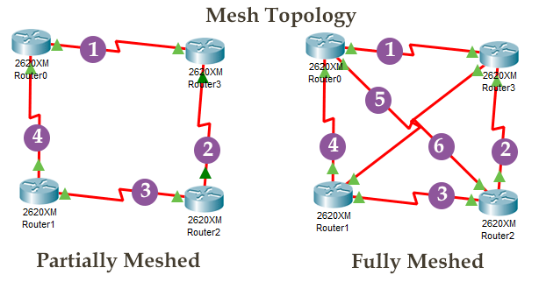
Mesh Topology
In this topology, multiple paths exist between end devices. Based on paths, a mesh topology can be divided into two types; fully meshed and partially meshed. If a direct path exists from each end device to every other end device in the network, it’s a fully meshed topology. If multiple paths exist between the end devices in the network, it’s a partially meshed topology.

Slide 26
Advantages of Mesh topology:
Fault is diagnosed easily.
Data is reliable because data is transferred among the devices through dedicated channels or links.
Drawbacks of Mesh topology:
Installation and configuration is difficult.
Cost of cables are high as bulk wiring is required.
Cost of maintenance is high.

Slide 27
Network Architecture
Network architecture defines how the computers are connected along with their roles in the network.
Client-Server
Peer-to-Peer
In the client-server architecture, there are client and server nodes. Servers are nodes that have software, which enable them to provide services and information. A server can provide many services, simultaneously, to one or many clients.
A simple peer-to-peer network can have two directly connected nodes using a wired or wireless connection. Multiple nodes connected to a network device, such as a hub, create a larger peer-to-peer network.

Slide 28
Comparison between the peer-to-peer and client-server architecture.
Peer-To-Peer Architecture | Client-Server Architecture
Easy to set up | More difficult to set up
Less expensive to install | More expensive to install
Can be implemented on a wide range of operating systems | Server needs an operating system that supports networking
Low level of security | High level of security
Use in small network | Use in small and Big network
Each peer has its own data. | The data is stored in a centralized server

Slide 29
There are 3 types of transmission nodes, namely:
Transmission modes
Transmission modes
Simplex
Half Duplex
Full Duplex
Transmission modes depict the direction of the data flow between interconnected network nodes during data communication. These are also known as ‘communication’ modes.

Slide 30
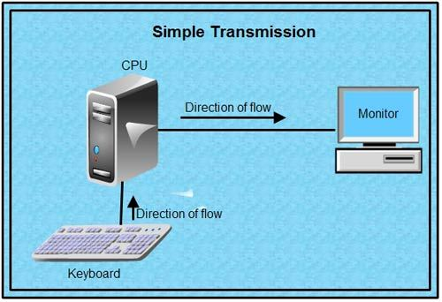
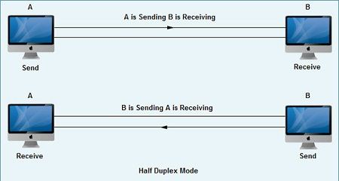
Simplex
Half Duplex
In this mode, data flow is unidirectional. This means data flow is in one direction either from the sender, or from the receiver.
In a half- duplex transmission mode, data flow is bidirectional. This means that there is transmission of data flow between sender and receiver in both directions.
Examples of Simplex mode
Example of half duplex mode

Slide 31
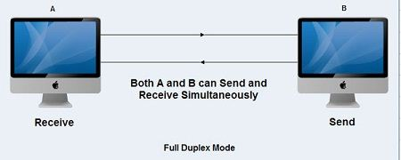
Full Duplex
In this mode, data is transmitted simultaneously between the sender and receiver in both directions over a serial link.
Example of Full duplex mode

Slide 32
Considerations for implementing a network
Changing default SSID
Service Set Identifier (SSID) is the network name for wireless network. The default SSID should be changed during the configuration so that other device can identify it. For securing this, password, channel number and encryption must be facilitated.
There are several practices for securing and implementing wireless and wired networks. These practices are discussed below.
Wireless Specific
Wireless network signal can easily be detected with the hardware. Thus, the security compromised exist in such networks. Several practice for securing wireless networks as follows:
WEP (Wireless Encryption Protocol)
Which provided a 40-bit key initially and later strengthened to 128-bit.

Slide 33
WPA (Wi-Fi Protected Access)
Disabling SSID broadcast
Overcome the shortcomings of WEP and can be combined with encryption standards such as TKIP (Temporal Key Integrity Protocol). Later, WPA-2 came which is a secure implementation of WPA that uses both TKIP and AES (Advanced Encryption Standard).
By default, SSID is broadcast by the router every few seconds. It is advisable to disable this.
Change default usernames and passwords
Network hardware such as router, switches and encryption mechanisms use usernames and passwords for authenticating users and thus, allowing configuration of devices. The passwords must be changed repeatedly and stronger passwords must be used each time they ate changed.
WPS (Wi-Fi Protected Setup)
Automates the process of setting up an access point securely.

Slide 34
Enable MAC filtering
Physical Security
Physical access to network infrastructure should be restricted to administrators and technicians. The hardware should be in an authorized area where only authorized personnel can enter.
Every network is assigned a unique 48-bit hexadecimal MAC address. Users having access to a wireless network can be limited by filtering devices using MAC addresses. Due to this, all the neighboring devices can’t access the network.
Assign static IP addressing
IP addresses are assigned automatically by DHCP protocol. This saves time and effort by managing and assigning addresses from the address pool. But these are temporary addresses and may change periodically. Clients must be configured to join the network by assigning static IP addresses.
Update Firmware
To augment the performance, to add new features and to fix security holes, firmware must be updated.

